Slide 1
Category review: Chips
May 2022
Retail Analytics
Brand note: If client logo is not required, use alternate title page layout right click slide thumbnail > Layout > Title

Slide 2
Notes:
To view Privacy video explaining how important data privacy is to Quantium, please click here: https://www.youtube.com/watch?v=Zq1QDAkoRzU
or here Q:\Company Reference\Brand & Design\Brand videos\Q Privacy.mp4
At Quantium, we believe that data is the behavioural footprint of humanity and that it has to be treated with the utmost care and responsibility.
Histories, attitudes, indeed lives are stored within it in ways that aren’t always apparent – and that’s what makes its potential so powerful.
To work with it responsibly, sensitively, we set ourselves the highest data privacy protection and governance standards.
We have spent 17 years perfecting privacy-by-design and secure-by-design principles. Central to this is not holding any personally identifiable information about people –
we neither receive it, and put the necessary protections in place to be unable to decipher it.
Every aspect of handling data is safeguarded: from its de-identification, to its encryption – data security is paramount and of the highest grade.
We pride ourselves on gaining the trust of iconic organisations around the world through years of securely working with their data,
and in turn the trust that builds with their stakeholders.

Slide 3
Executive summary
01
Task 1
1. Sales have mainly been due to Budget - older families, Mainstream - young singles/couples, and Mainstream- retirees' shoppers.
2. We found that the high spend in chips for mainstream young singles/couples and retirees is due to there being more of them than other buyers.
3. Mainstream, mid-age and young singles and couples are also more likely to pay more per packet of chips. This is indicative of impulse buying behaviour.
4. We’ve also found that Mainstream young singles and couples are 23% more likely to purchase Tyrrells chips compared to the rest of the population.
02
Task 2
We’ve found control stores 233, 155, 237 for trial stores 77, 86, and 88 respectively.
The results for trial stores 77 and 88 during the trial period show a significant difference in at least two of the three trial months but this is not the case for trial store 86.
We can check with the client if the implementation of the trial was different in trial store 86 but overall, the trial shows a significant increase in sales.

Slide 4
01
Data preparation and customer analytics
Budget - older families, Mainstream - young singles/couples, and Mainstream- retirees' shoppers contribute a lot to sales. Mainstream young singles/couples and retirees are due to there being more of them than other buyers.
Mainstream, mid-age, and young singles and couples are likely to pay more per packet of chips. Mainstream young singles and couples are 23% more likely to purchase Tyrrells chips compared to the rest of the population. Also, 26.8% affinity to pack sizes of 270g.
The Category Manager may want to increase the category’s performance by off-locating some Tyrrells and smaller packs of chips in discretionary space near the segment where young singles and couples frequent more often to increase visibility and impulse behavior.

Slide 5
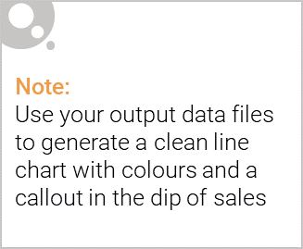
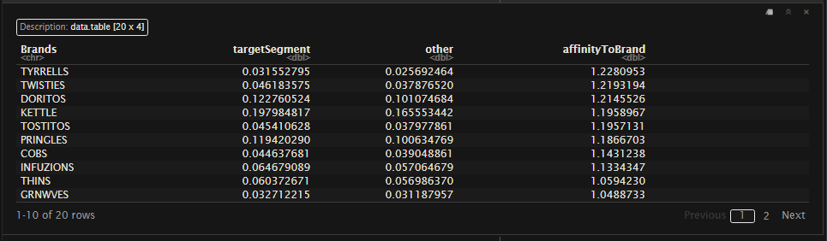
High Brand Affinity towards Tyrell Chips

Slide 6
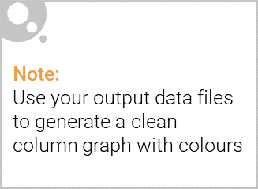
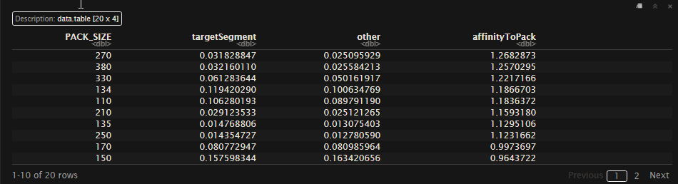
High affinity to pack size of 270g

Slide 7
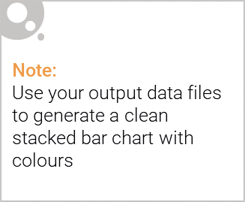
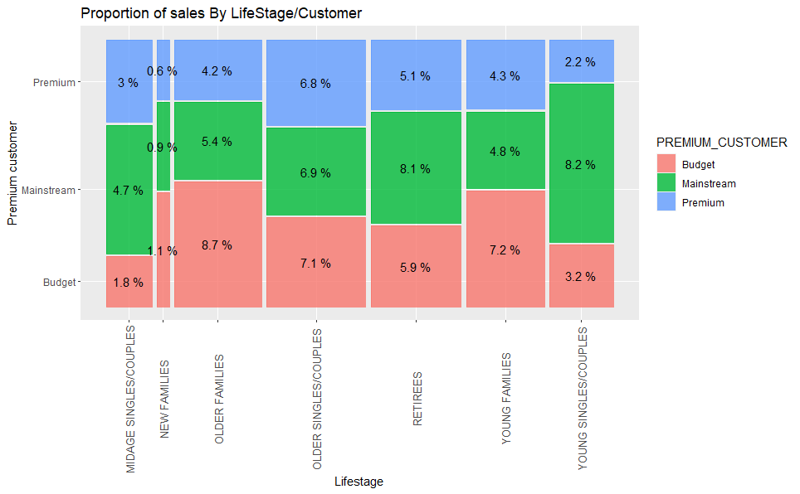
Editable (delete this)
Sales by Premium Customers and Lifestages

Slide 8
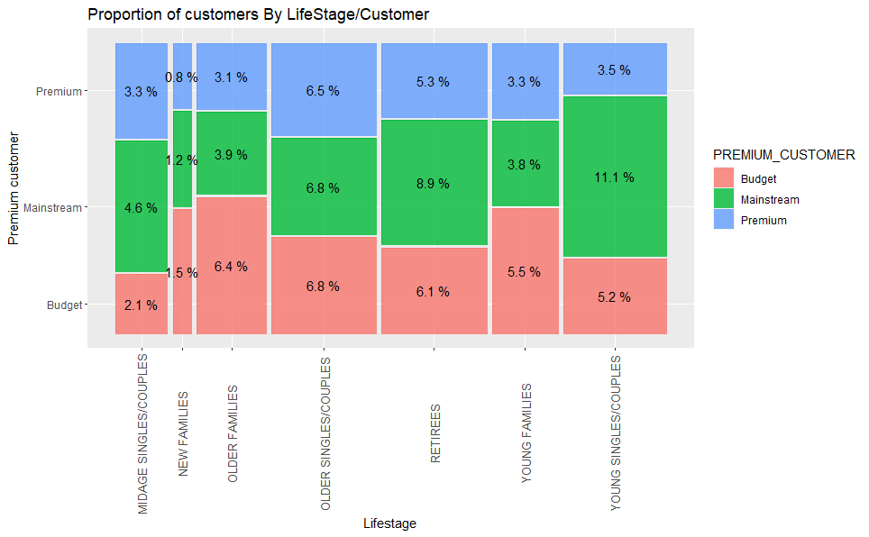
Customers by affluence and life stage

Slide 9
02
Trial store performance

Slide 10
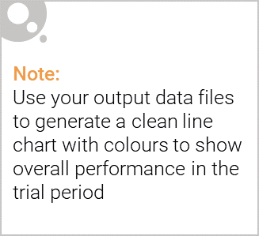
Explanation of the control store vs other stores
We would want to match trial stores to control stores that are similar to the trial
store prior to the trial period of Feb 2019 in terms of :
- Monthly overall sales revenue
- Monthly number of customers
- Monthly number of transactions per customer
We compare the correlation and magnitude of the trial stores with all the stores and find which performs similarly to the selected trial store. This is checked for performance before the trial period We also check the hypothesis for this and vie it visually.
With the selected control store we compare it with the trial store for the trial period and check if the recommendations were given before work or not.

Slide 11
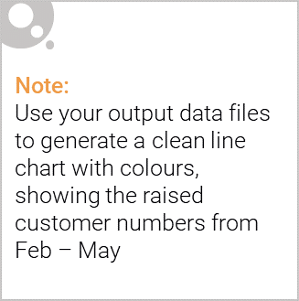
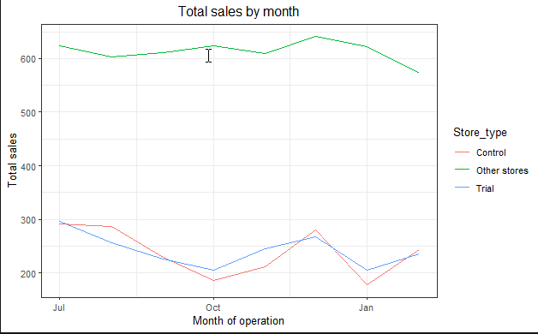
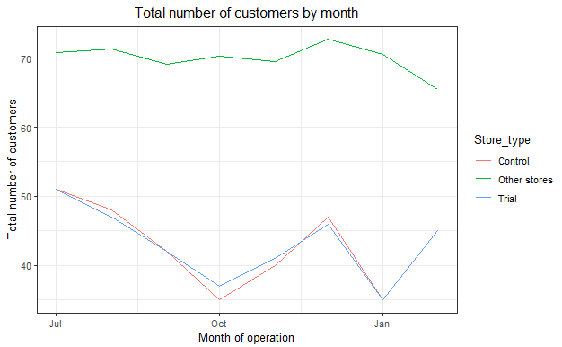
Performance of 77 (trial store) and 233 (control store)

Slide 12
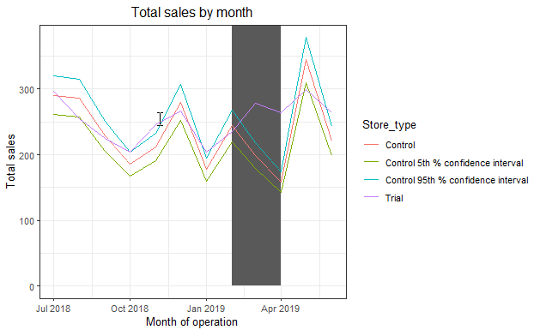
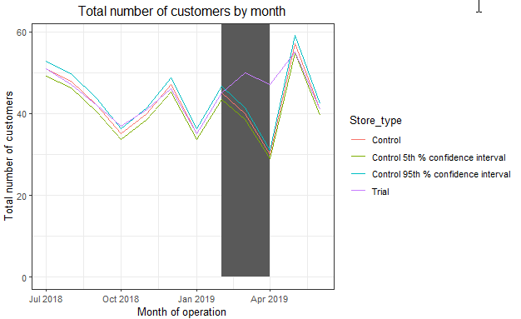
Call out of the performance in the trial store, determining if it was successful

Slide 13
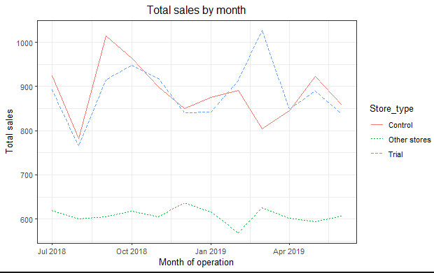
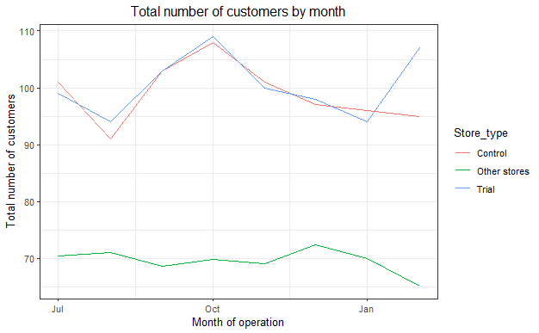
Performance of 86 (trial store) and 155 (control store)

Slide 14
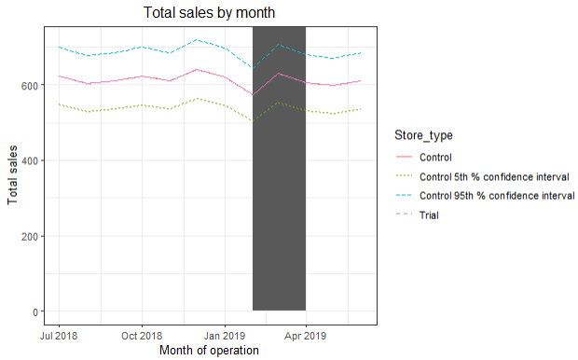
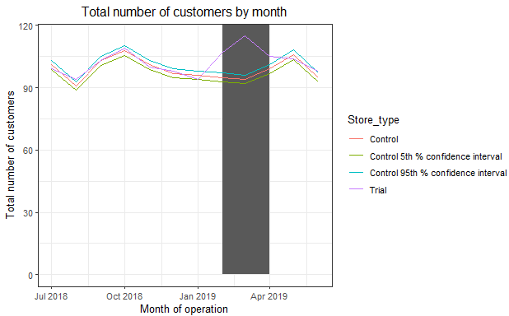
Call out of the performance in the trial store, determining if it was successful

Slide 15
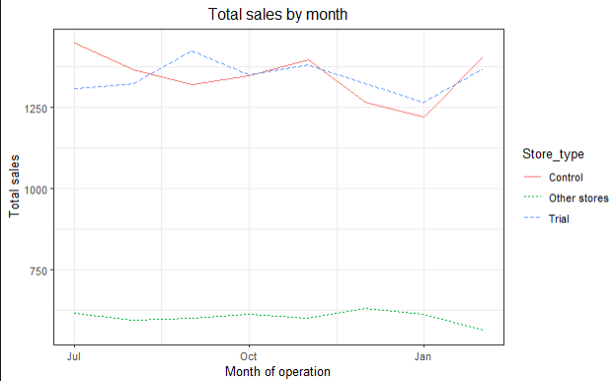
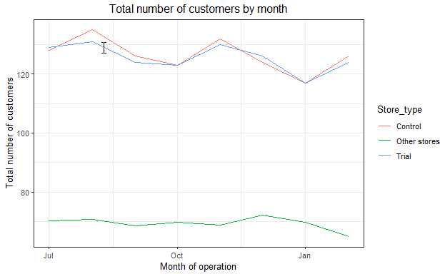
Performance of 88 (trial store) and 237 (control store)

Slide 16
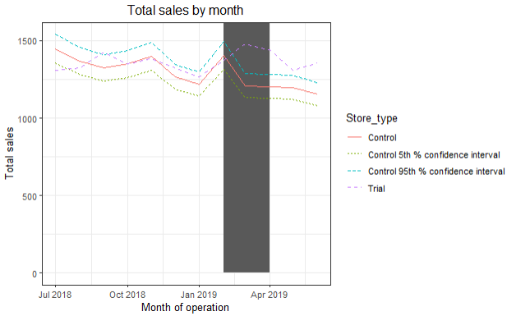
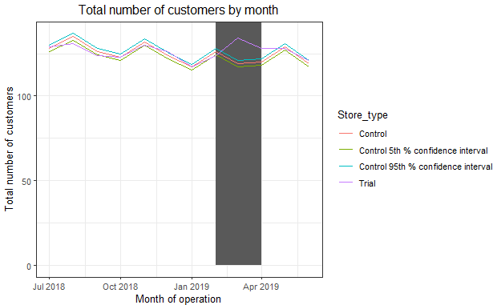
Call out of the performance in the trial store, determining if it was successful

